Slide 1

BRAIN STROKE DETECTION USING ML ALGORITHMS
Group Number - 22
Gousia Patthan
Manpreet Singh Sandhu
SAT 5141
Clinical Decision Support & AI Modelling

Slide 2
INTRODUCTION
Brain strokes pose a significant global health challenge, emphasizing the need for proactive measures and prevention strategies.
This study aims to predict the risk of brain stroke using advanced AI models and to compare their accuracy to identify the most effective model.
The dataset utilized for this study comprises nearly 5000 patient records sourced from Kaggle, encompassing crucial attributes such as age, gender, blood pressure levels, smoking status, body mass index (BMI), and stroke history.

Slide 3
LITERATURE REVIEW
Recent research have shown that there are ways we can predict stroke prior its occurrence.
They used the Data Mining techniques to generate vast amount of data which can be used to train the model and predict the outcome of new incoming patient.
They have used SVM model to predict the outcomes from the data and training the model with different kernels.
Our aim is not only to use one ML algorithm but to deploy several and select the model with highest accuracy.
Also we will be using the feature selection method to select the attributes with high importance.

Slide 4
DATASETS
We have selected our dataset from Kaggle.
The data have various attributes that contribute to the stroke such as the smoking history, Hypertension, BMI, Blood glucose levels and several other attributes.
The Dataset is original patient dataset which consists of nearly 5000 patient records.
Despite the data is highly unbalance towards the target attribute which is stroke we are performing statistical techniques to upsample the data and balance the dataset, rest several attributes are highly balance and can help us to train our model efficiently.
SMOTE - Synthetic Minority Oversampling Technique

Slide 5
TYPE OF APPROACH
Collecting the data from the Datasource using the Kaggle API.
Performing Data cleaning operations.
Using SMOTE to balance the dataset.
Performing the Exploratory Data Analysis using Pandas,Numpy, Matplotlib and Seaborn libraries.
Using Scikit Labelencoder Library
Finding the Skewness of the dataset.
Creating Correlation matrix to come up with a conclusion which attributes have a possible linear relationship with the output.

Slide 6
TYPE OF APPROACH
Selecting the important features from the dataset using Random Forest Classifier.
Splitting the dataset into 3 parts training set, validation set and test set.
Using the Import features finding the accuracy for every ML model such as KNN, SVM, RF, LR.
Selecting the model with the best test set accuracy, F1 score, Precision and Recall value.
Deploying the model to make future predictions.

Slide 7
EDA
We are performing EDA on every attribute which is a categorical data to know the distribution of data and know if it is balanced or not.
Using the Label Encoder library we will be able to convert categorical data labels to 0’s, 1’s and so on.
Now we are performing correlation on the dataset to know what all attributes are highly correlated and which are not.
Performing the histogram plot on the dataframe to summarize discrete or continuous data that are measured on a particular interval.

Slide 8
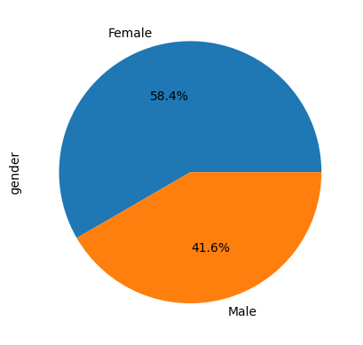
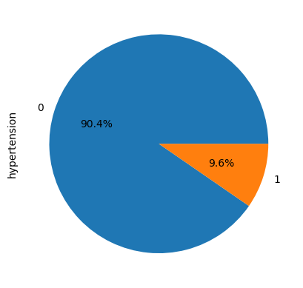
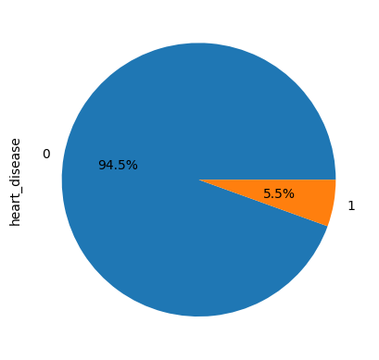
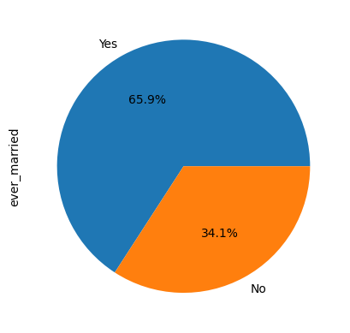
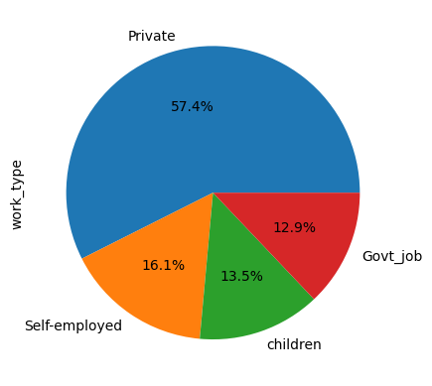
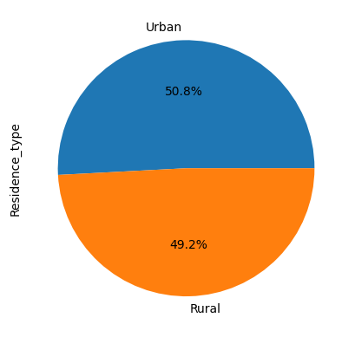
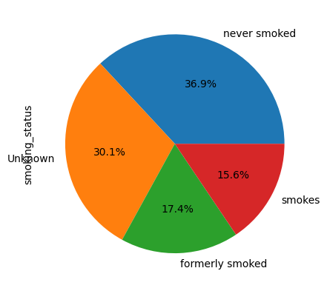
EDA

Slide 9
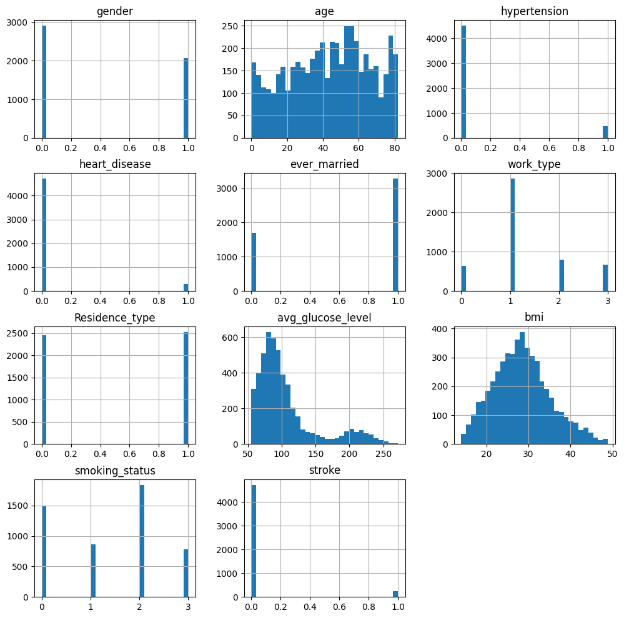
EDA

Slide 10
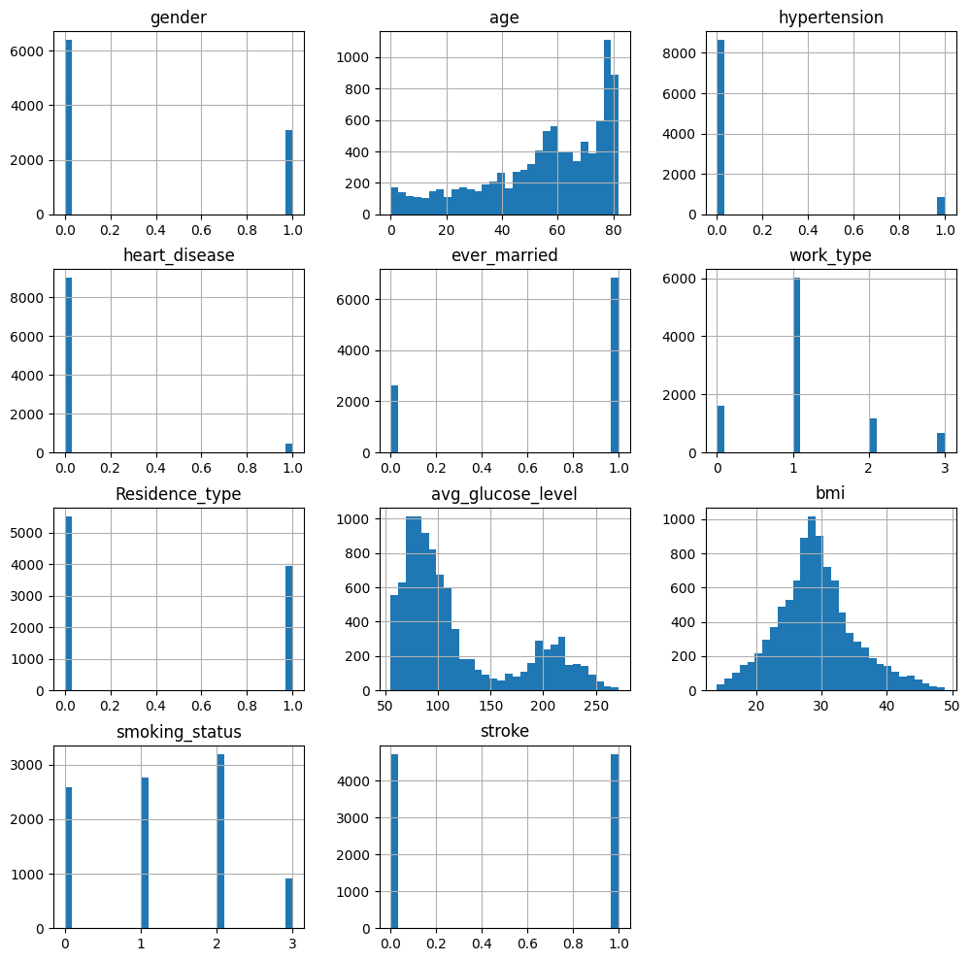
EDA

Slide 11
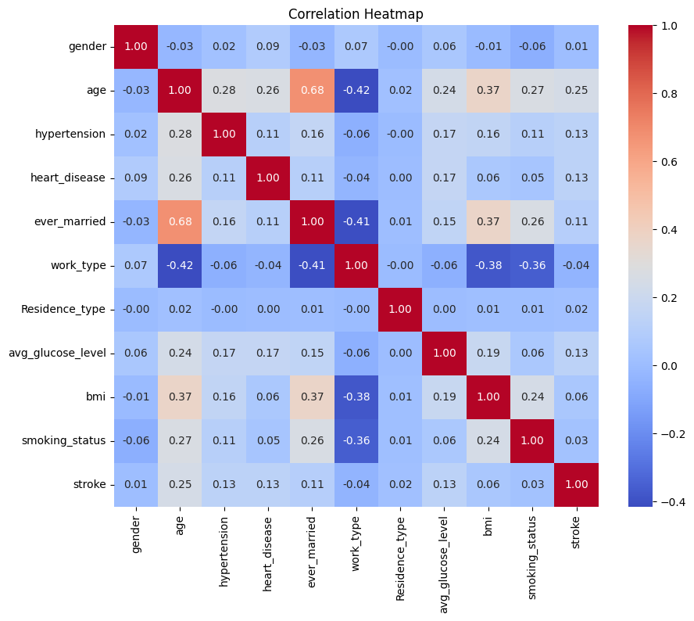
EDA

Slide 12
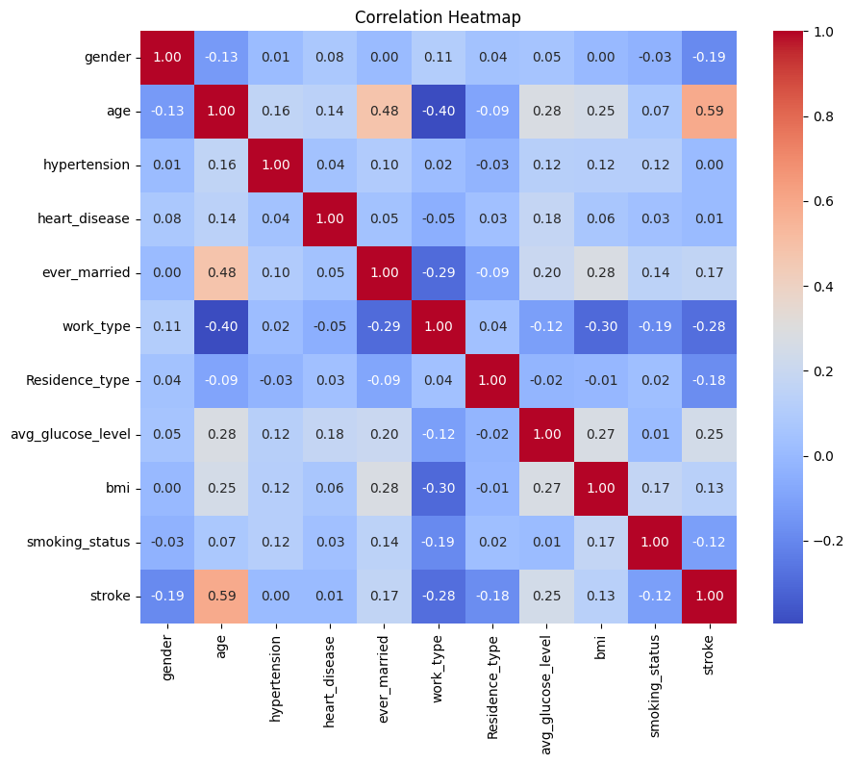
EDA

Slide 13
MODEL ARCHITECTURE
Dataset Collection
Normalization and Preprocessing
Feature Subset Selection using Relevant Attributes
Deployment of Model
Result Analysis
Classification Algorithm

Slide 14
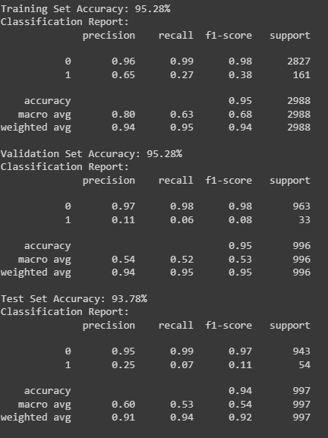
RESULTS

Slide 15
RESULTS
MODEL/SET | TRAINING SET | VALIDATION SET | TEST SET
KNN | 95.28% | 95.28% | 93.78%
RANDOM FOREST | 99.97% | 96.69% | 94.18%
LOGISTIC REGRESSION | 94.61% | 96.69% | 94.58%

Slide 16
RESULTS WITH CROSS VALIDATION
MODEL/SET | AVG. TRAINING SET | AVG. TEST SET
KNN | 95.77% | 93.42%
RANDOM FOREST | 99.97% | 94.80%
LOGISTIC REGRESSION | 95.01% | 95.01%

Slide 17
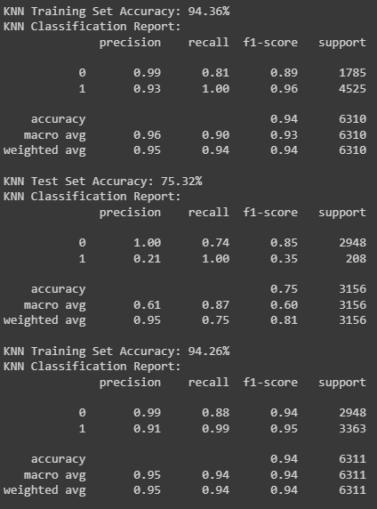
RESULTS AFTER SMOTE

Slide 18
RESULTS WITH CROSS VALIDATION AFTER SMOTE
MODEL/SET | AVG. TRAINING SET | AVG. TEST SET | F1 SCORE
KNN | 94.45% | 89.80% | 0.89(89%)
RANDOM FOREST | 99.97% | 93.45% | 0.92(92%)
LOGISTIC REGRESSION | 80.84% | 80.84% | 0.74(74%)
DECISION TREES | 100% | 100% | 0.86(86%)
SVM | 77.83% | 81.07% | 0.75(75%)
LINEAR REGRESSION | 81.03% | 81.03% | 0.74(74%)

Slide 19
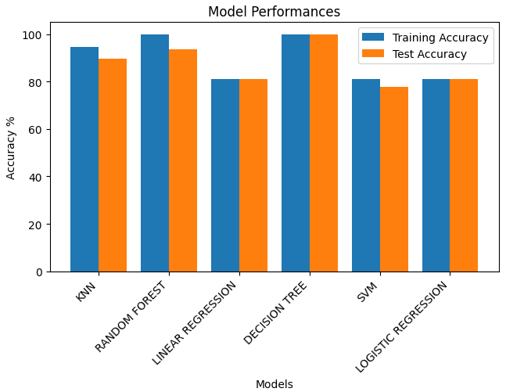
RESULTS WITH CROSS VALIDATION AFTER SMOTE

Slide 20
CONCLUSION
ML algorithms can be used as an important tool in medical field.
Our main objective from this work was to develop a ML based approach to predict brain stroke with consideration of several Attributes.
Considering the research done previously which involved SVM the highest accuracy which was achieved was only 91 %.
While on the other hand after balancing the data set our model is having the accuracy of 93.45% using Random Forest classifier.
Our model is also having better F1 score of 0.92 compared to the model of SVM.
Our method can be extended to large datasets which also involves more attributes so as to improve its performance.

Slide 21
REFERENCES
Designing an Artificial Neural Network Model for the Prediction of Thrombo-embolic Stroke
Stroke prediction using SVM
Effective Analysis and Predictive Model of Stroke Disease using Classification Methods
Stroke risk prediction using machine learning: a prospective cohort study of 0.5 million Chinese adults
A predictive analytics approach for stroke prediction using machine learning and neural networks
Designing an Artificial Neural Network Model for the Prediction of Thrombo-embolic Stroke
Working with Imbalance Data sets
Dataset

Slide 22
THANK YOU

